Slide 1

Library management system
Store book titles
Add new books
Remove books
Search for a specific book
Sort

Slide 2
public:
// Constructor to initialize the array
BookList(int initialCapacity = 10);
// Destructor to clean up memory
~BookList();
// Function to add a book title
void addBook(const std::string& bookTitle);
// Function to remove a book title
void removeBook(const std::string& bookTitle);
// Function to search for a book title
bool searchBook(const std::string& bookTitle) const;
// Function to list all books
void listBooks() const;
// Function to sort books alphabetically
void sortBooks();
};
#include <string>
// Class to manage a list of book titles
class BookList {
private:
std::string* books; // Dynamic array to store book titles
int capacity; // Maximum capacity of the array
int size; // Current number of books in the array
// Helper function to expand the array when it gets full
void resize();
Manually implement
Custom functions
Handle memory management yourself

Slide 3
public:
// Constructor to initialize the array
BookList(int initialCapacity = 10);
// Destructor to clean up memory
~BookList();
// Function to add a book title
void addBook(const std::string& bookTitle);
// Function to remove a book title
void removeBook(const std::string& bookTitle);
// Function to search for a book title
bool searchBook(const std::string& bookTitle) const;
// Function to list all books
void listBooks() const;
// Function to sort books alphabetically
void sortBooks();
};
#include <string>
// Class to manage a list of book titles
class BookList {
private:
std::string* books; // Dynamic array to store book titles
int capacity; // Maximum capacity of the array
int size; // Current number of books in the array
// Helper function to expand the array when it gets full
void resize();
Time-Consuming Development
Error-Prone Code
Lack of Reusability and Flexibility
Manually implement
Custom functions
Handle memory management yourself

Slide 4
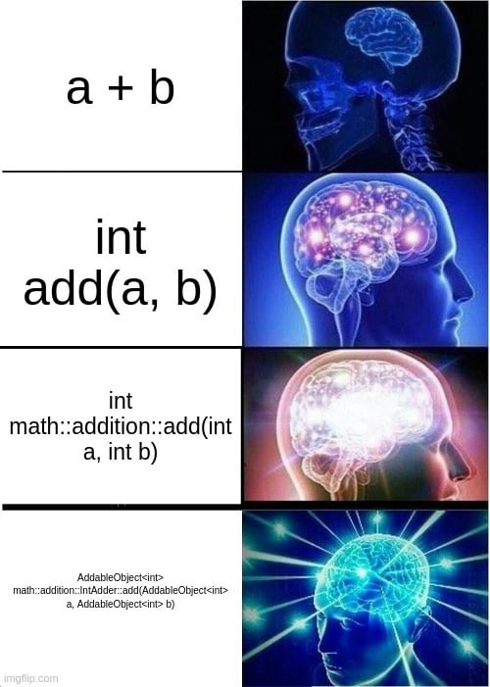
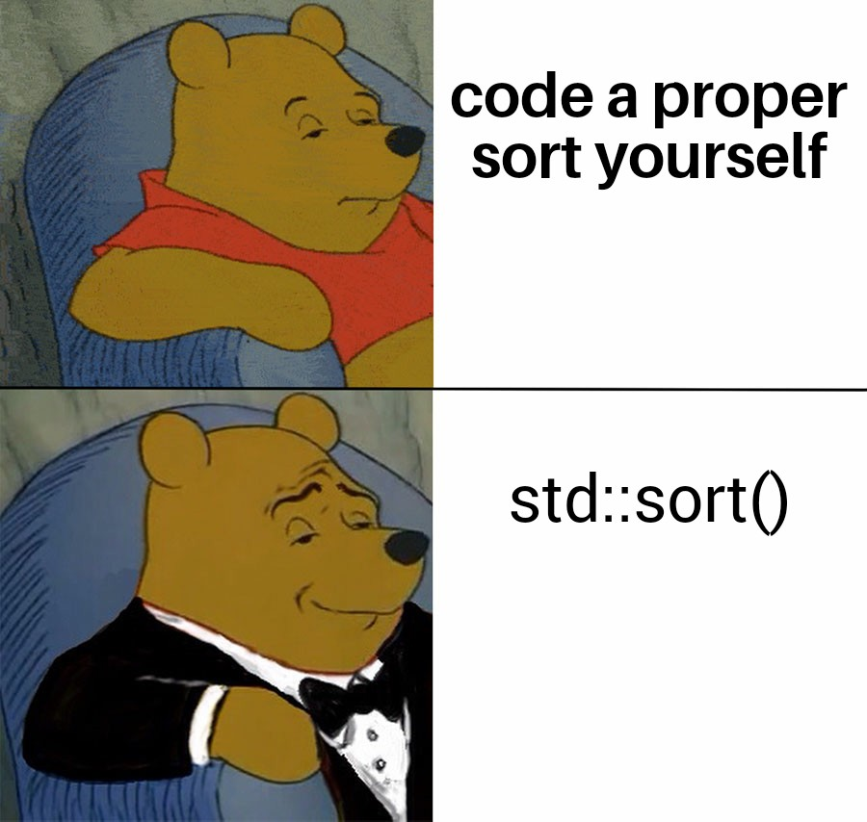
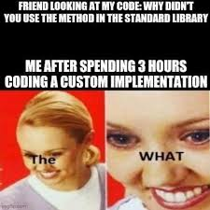

Slide 5


Slide 6
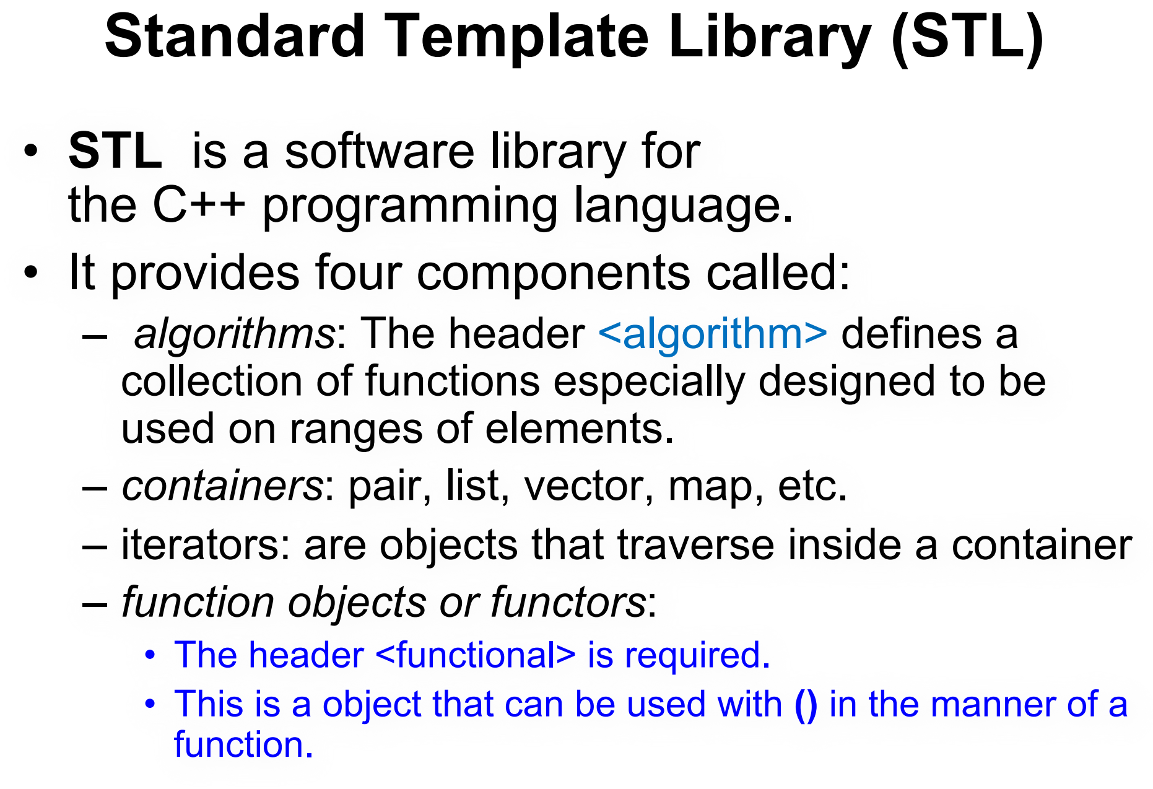

Slide 7
Algorithms
std::sort
std::find
std::reverse
std::copy
std::sort(beginIterator, endIterator);
auto it = std::find(beginIterator, endIterator, value);
std::reverse(beginIterator, endIterator);
std::copy(beginSource, endSource, beginDestination);
#include <algorithm>

Slide 8
Containers
Variety of Containers:
Sequence Containers
Vector
list
Deque
Associative Containers
map
set
Unordered Containers (C++11 onwards)
unordered_map
unordered_set
Pairs: std::pair is a utility container that stores two values

Slide 9


Slide 10
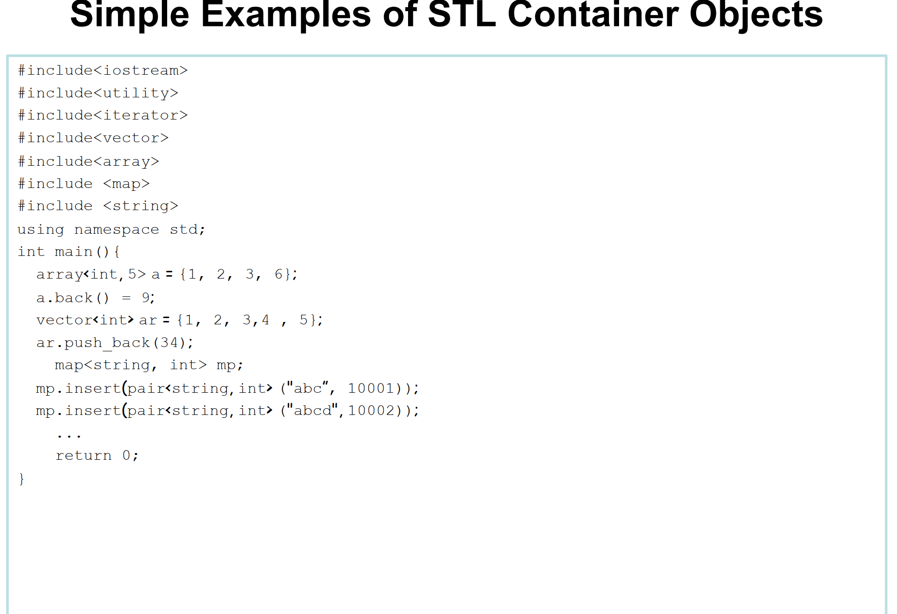

Slide 11
#include <vector>
#include <iostream>
int main() {
std::vector<int> vec = {1, 2, 3};
vec.push_back(4); // Add an element to the end
for (int v : vec) {
std::cout << v << " "; // Output: 1 2 3 4
}
return 0;
}
#include <list>
#include <iostream>
int main() {
std::list<int> lst = {1, 2, 3};
lst.push_back(4); // Add an element to the end
lst.push_front(0); // Add an element to the beginning
for (int v : lst) {
std::cout << v << " "; // Output: 0 1 2 3 4
}
return 0;
}
Vector
List
#include <map>
#include <iostream>
int main() {
std::map<std::string, int> age;
age["Alice"] = 25;
age["Bob"] = 30;
// Accessing elements
std::cout << "Alice's age: " << age["Alice"] << std::endl; // Output: Alice's age: 25
return 0;
}
#include <deque>
#include <iostream>
int main() {
std::deque<int> dq = {1, 2, 3};
dq.push_back(4); // Add an element to the end
dq.push_front(0); // Add an element to the beginning
for (int v : dq) {
std::cout << v << " "; // Output: 0 1 2 3 4
}
return 0;
}
Deque
Map

Slide 12
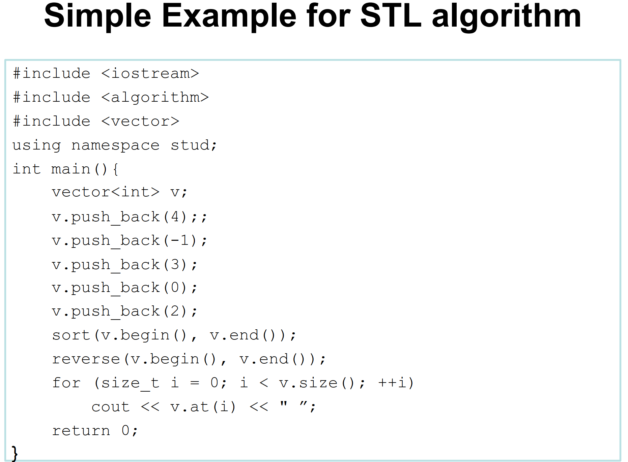
v = {4}
v = {4, -1}
v = {4, -1, 3}
v = {4, -1, 3, 0}
v = {4, -1, 3, 0, 2}
v = {-1, 0, 2, 3, 4}
sort(begin, end)
v = {4, 3, 2, 0, -1}

Slide 13
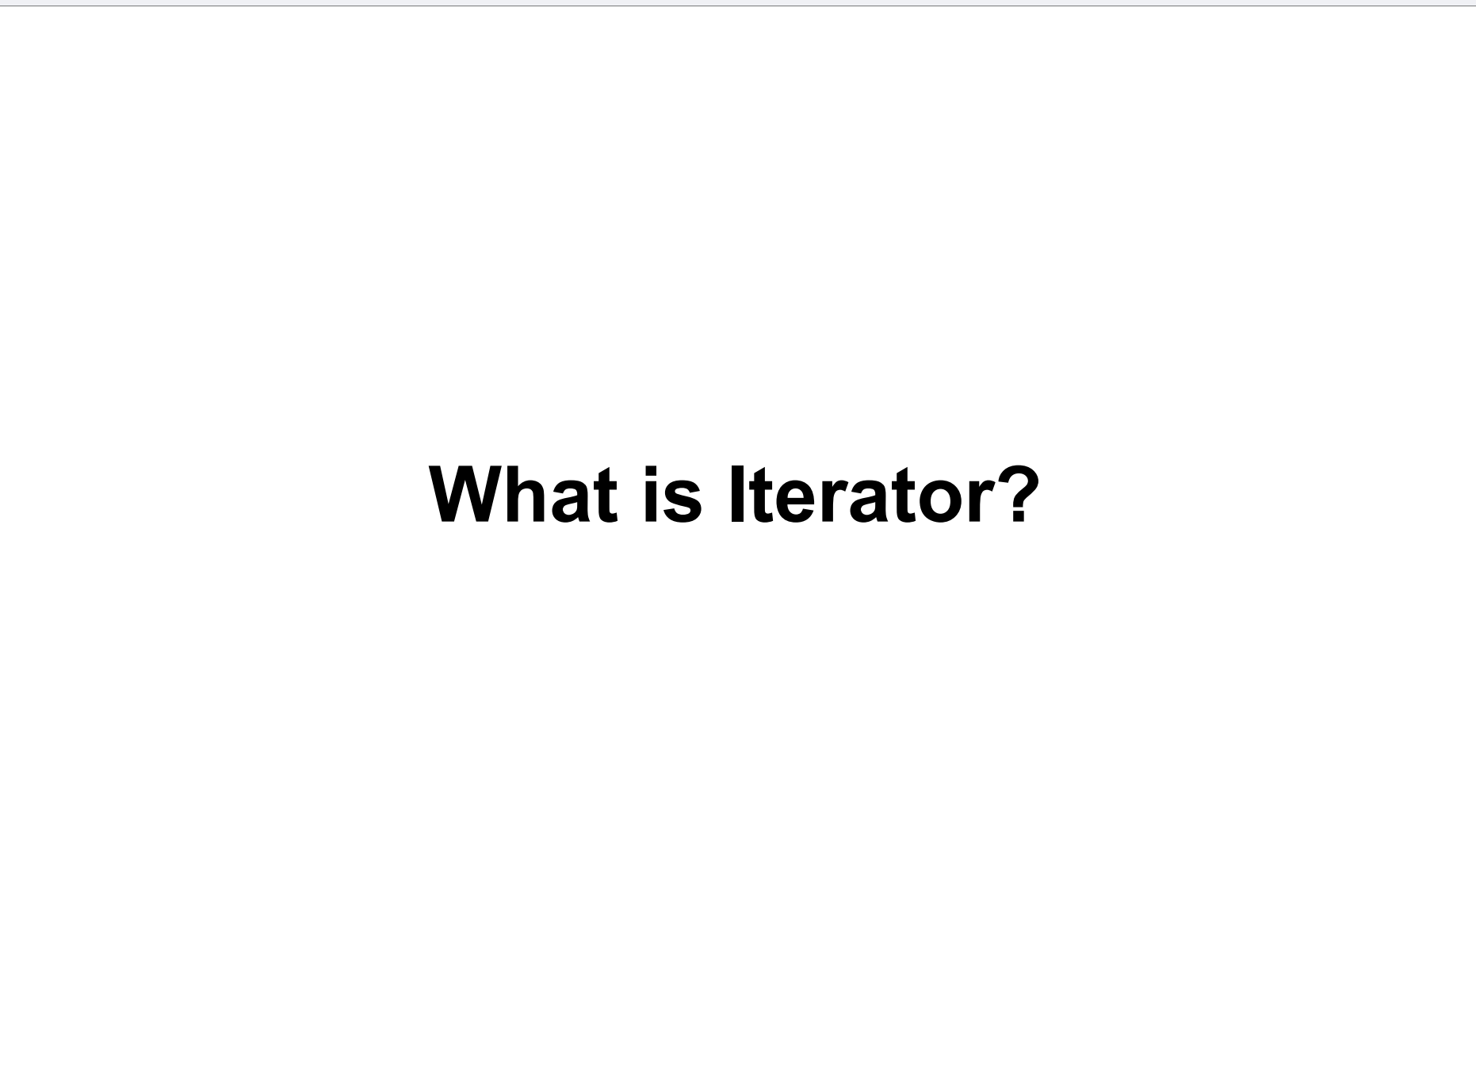

Slide 14
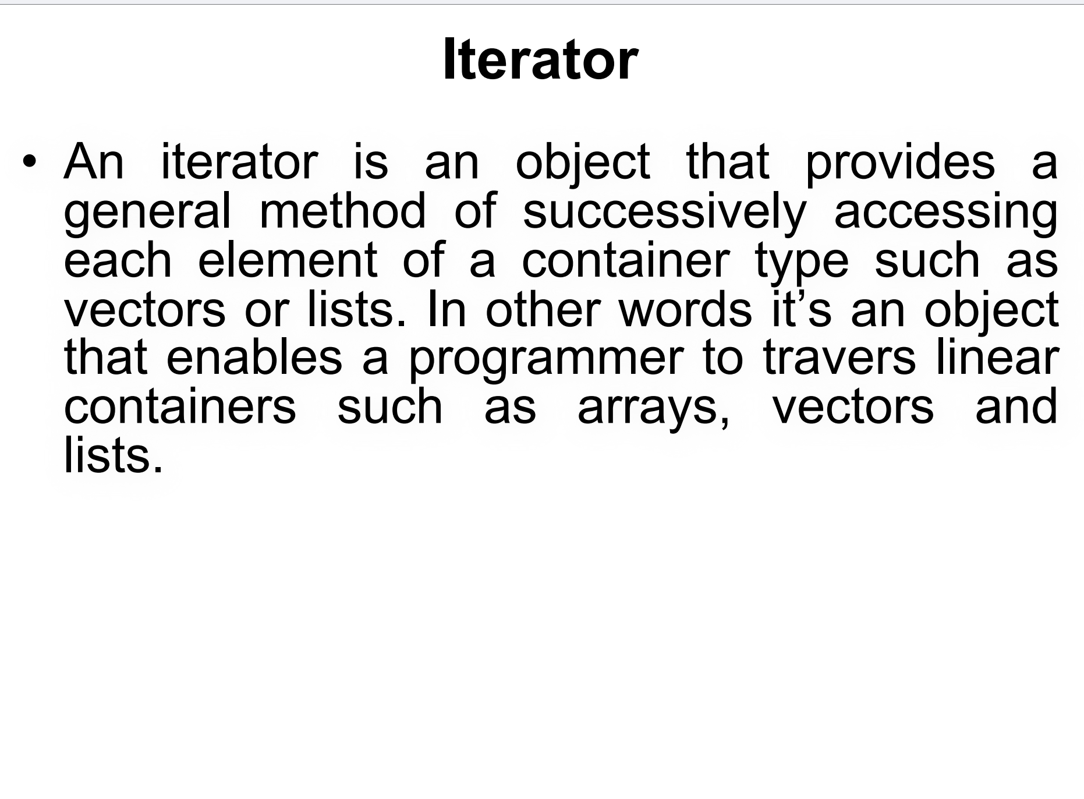

Slide 15
Iterator Types
Input Iterator
Output Iterator
Forward Iterator
Bidirectional Iterator
Random Access Iterator

Slide 16
How to Use an Iterator
Declare an Iterator
Traverse the Container
Access Elements

Slide 17
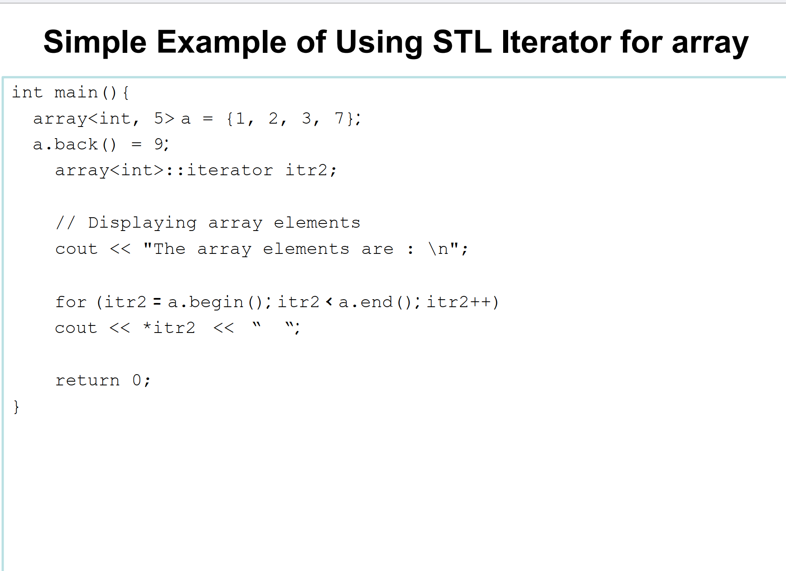

Slide 18
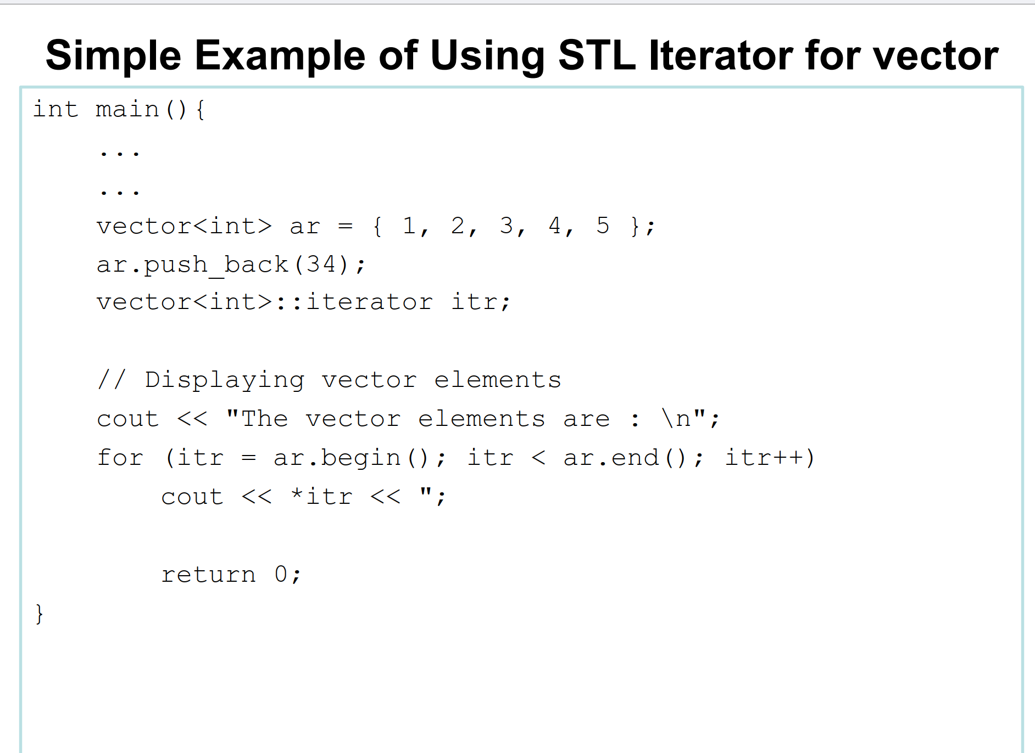
ar = {1, 2, 3, 4, 5, 34}

Slide 19
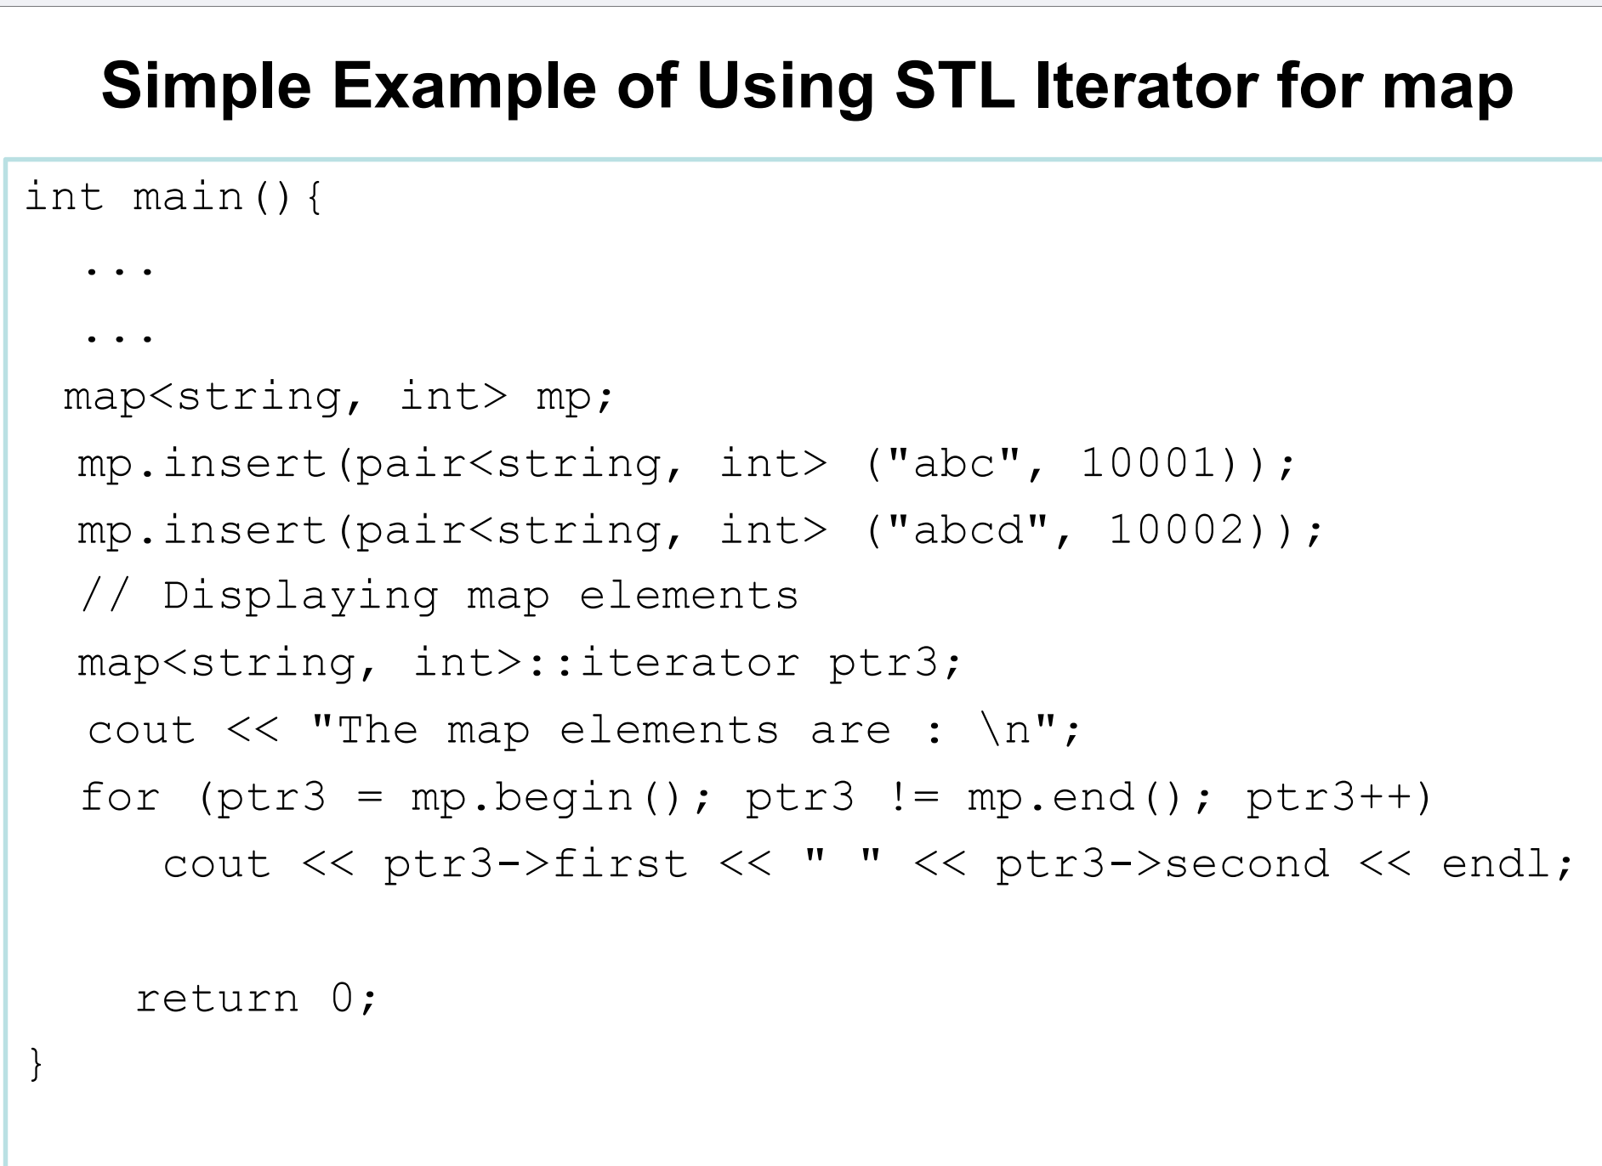
mp = {
"abc" : 10001,
"abcd" : 10002
}

Slide 20
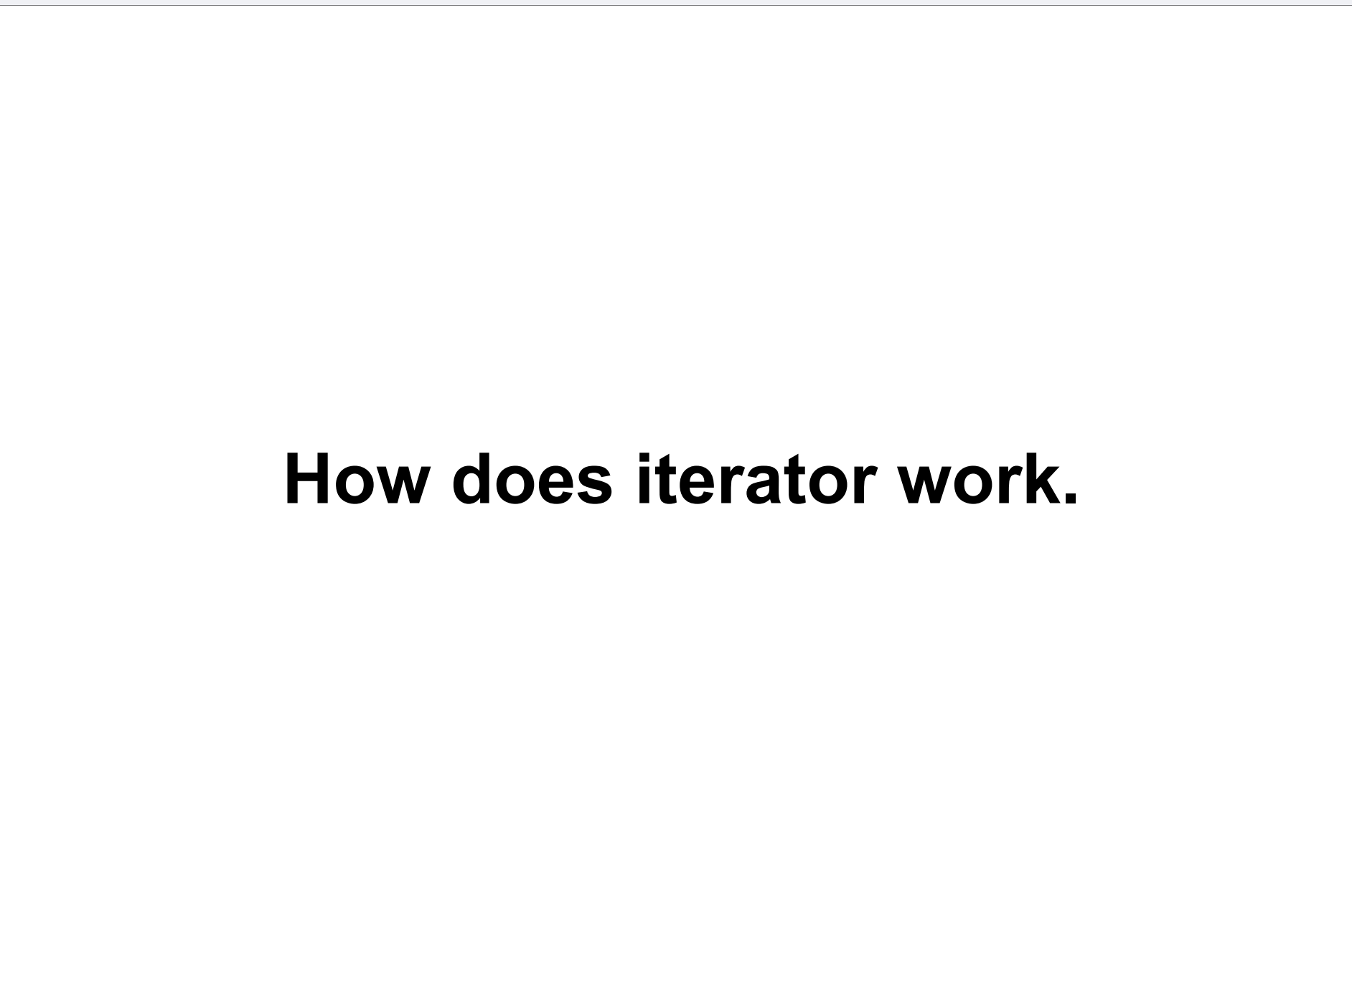

Slide 21
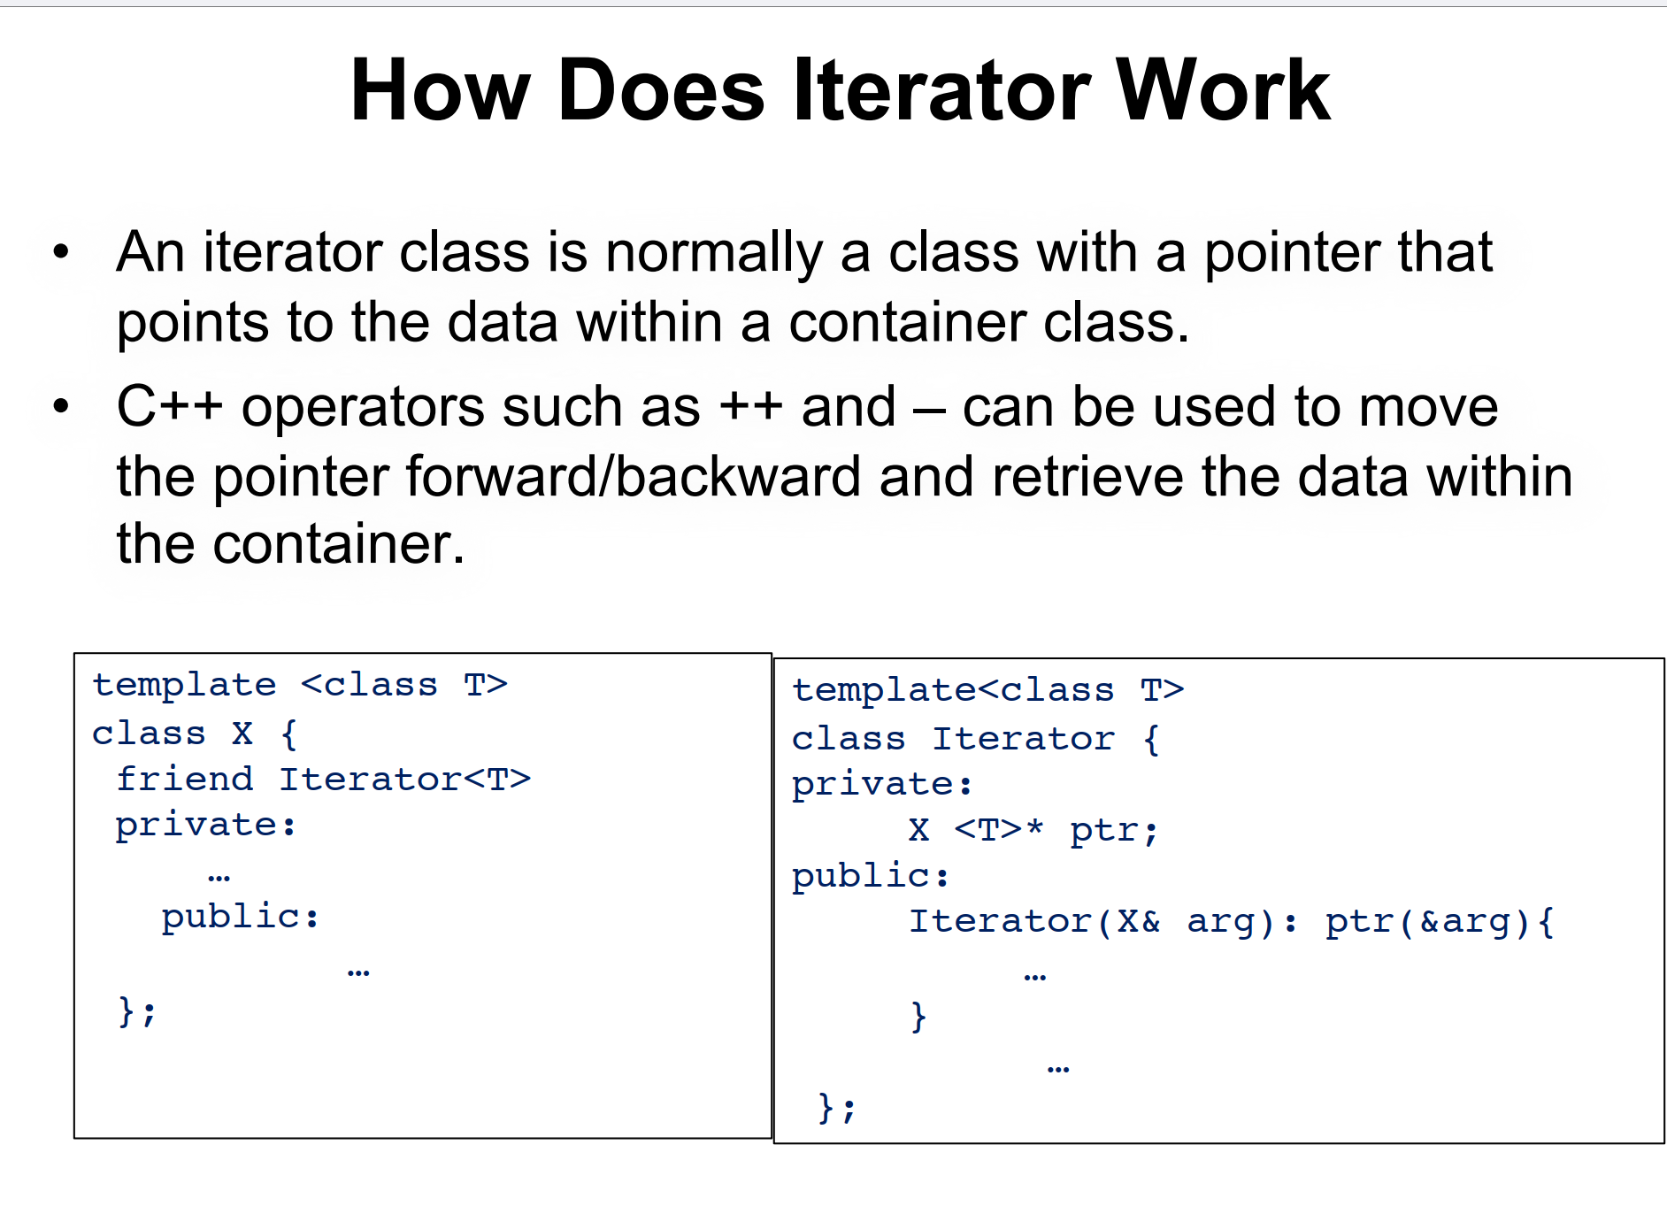

Slide 22
Typical Iterator Functions
T& operator*() {
return ptr->data; // Hypothetical access to data in the container
}
Dereference Operator (*):
Increment Operator (++)
Equality and Inequality Operators (==, !=)
Iterator& operator++() {
ptr = ptr->next; // Hypothetical movement in the container
return *this;
}
bool operator!=(const Iterator& other) const {
return ptr != other.ptr;
}

Slide 23
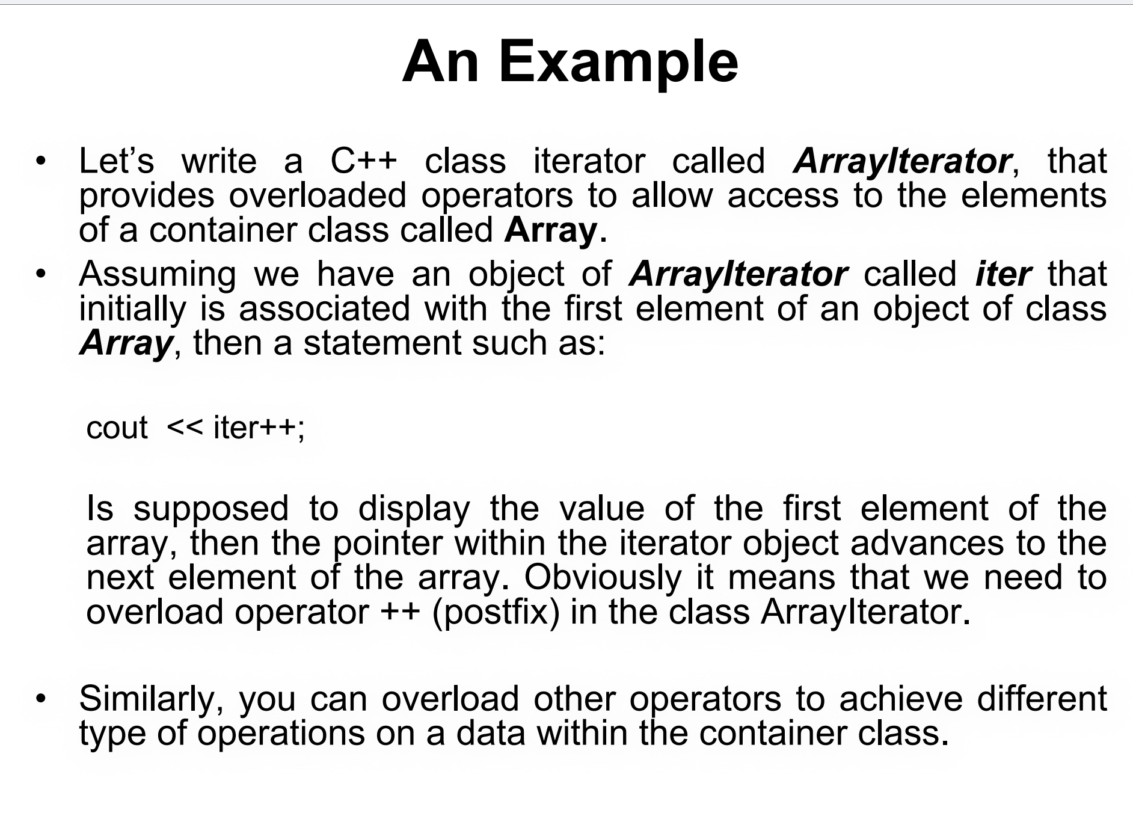

Slide 24
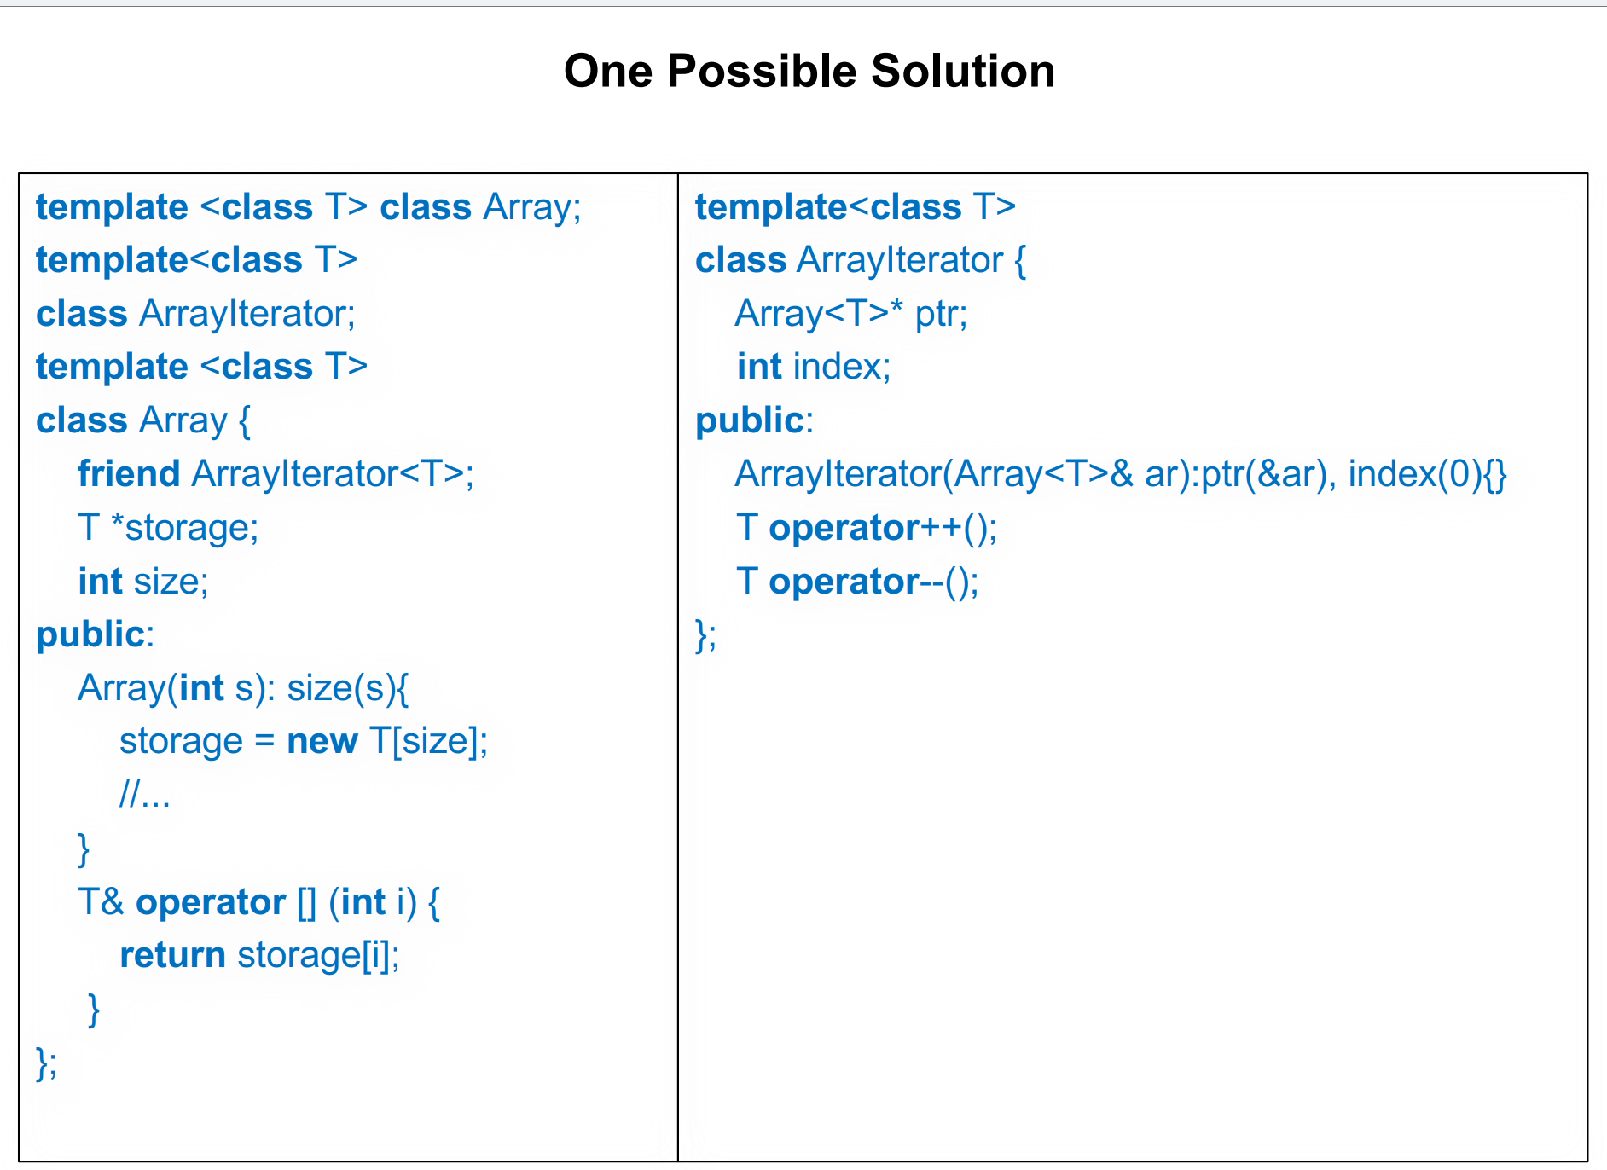

Slide 25
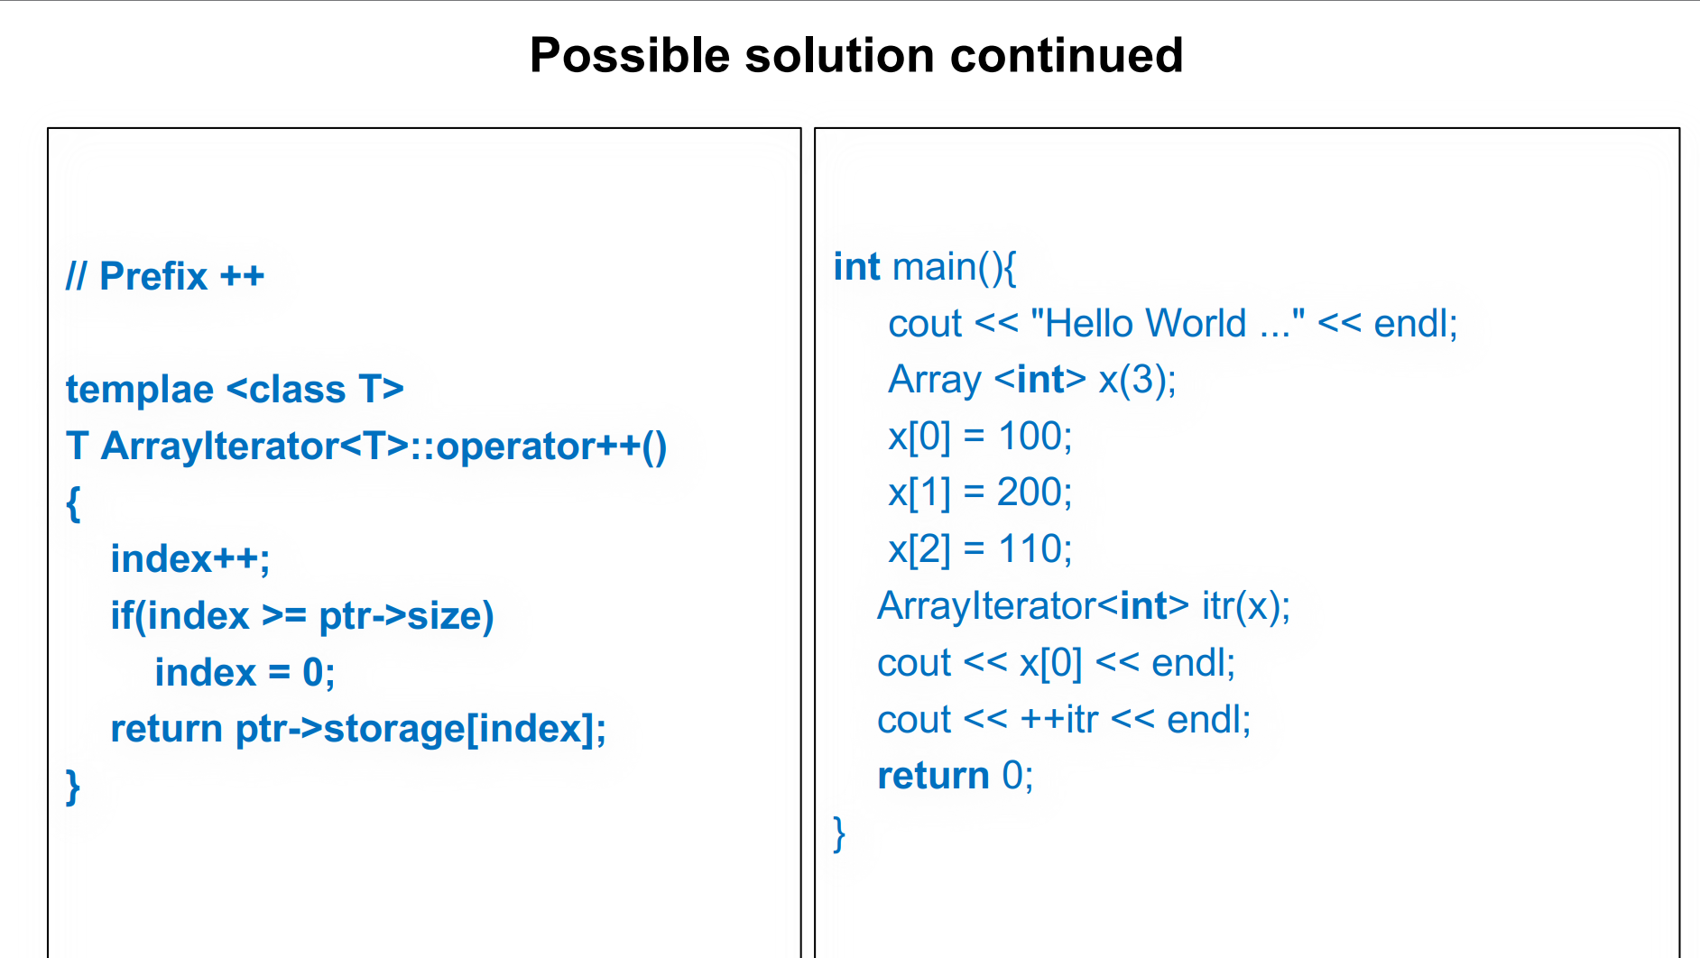
1
x = [100, 200, 110]
itr.ptr -> x
itr.index = 0
200
return ptr->storage[1]; // Access `x[1]`, which is `200`

Slide 26
Function Objects or Functors
In C++, a functor is any class or struct that overloads the () operator.
Header <functional> is Required.
std::plus, std::minus, std::multiplies, std::divides, etc
Using Functors Like Functions.
std::transform, std::sort, or std::accumulate

Slide 27
#include <iostream>
#include <vector>
#include <numeric> // For std::accumulate
#include <functional> // For std::multiplies
int main() {
// Create a vector of integers
std::vector<int> numbers = {1, 2, 3, 4, 5};
// Use std::accumulate to multiply all elements in the vector
int product = std::accumulate(
numbers.begin(), // Start of the range
numbers.end(), // End of the range
1, // Initial value for the product
std::multiplies<int>() // Functor to multiply elements
);
// Output the result
std::cout << "The product of all elements in the vector is: " << product << std::endl;
return 0;
}
Reduce a sequence of elements to a single value by applying a specified operation (e.g., summation, multiplication).
1 * 1 * 2 * 3 * 4 * 5 = 120

